Slide 1
Introduction to Python
Juan Chacon-Hurtado, Gerald Corzo

Slide 2
Definitions
Python is an interpreted programming language (like Matlab).
It is a generalised programming language.
Open source and free.
Cross-platform.
Designed to maximise code readability.
Extensive collaboration in academic and commercial environments.

Slide 3
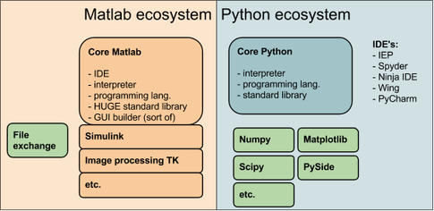
Matlab and Python
Notes:
http://www.quora.com/How-are-Python-and-MATLAB-related-Can-I-use-MATLAB-inside-Python

Slide 4
Parts
Interpreter (python, Ipython)
Executes the orders given in the script.
IDE - Integrated Development Environment
Has functionalities to help you writing scripts.
Spyder, PyCharm, WingIDE, Canopy, Eclipse, etc.
Libraries
Contains all the functions which are not part of the standard operations.
Numpy, Scipy, Matplotlib are good examples of libraries.

Slide 5
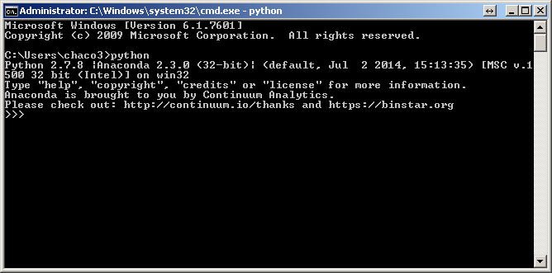
Interpreter

Slide 6
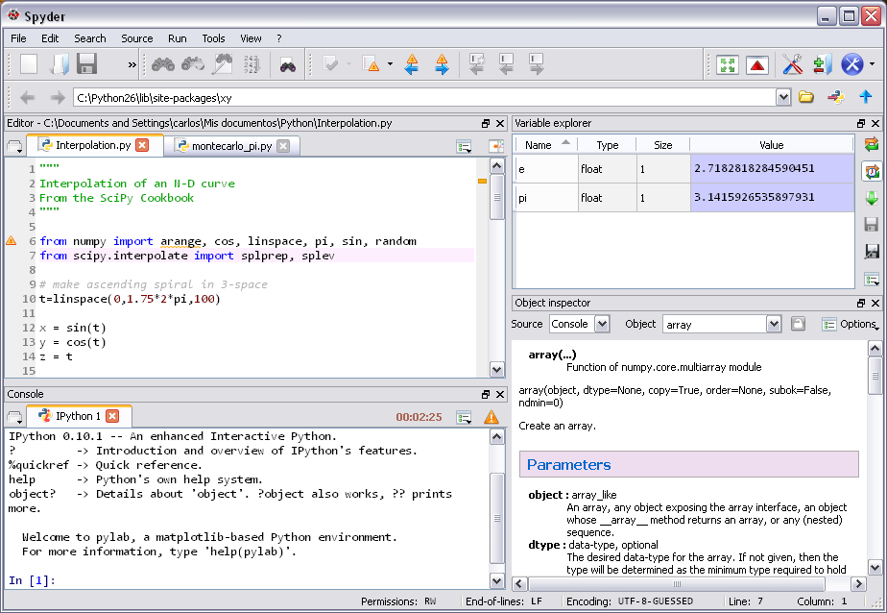
IDE

Slide 7
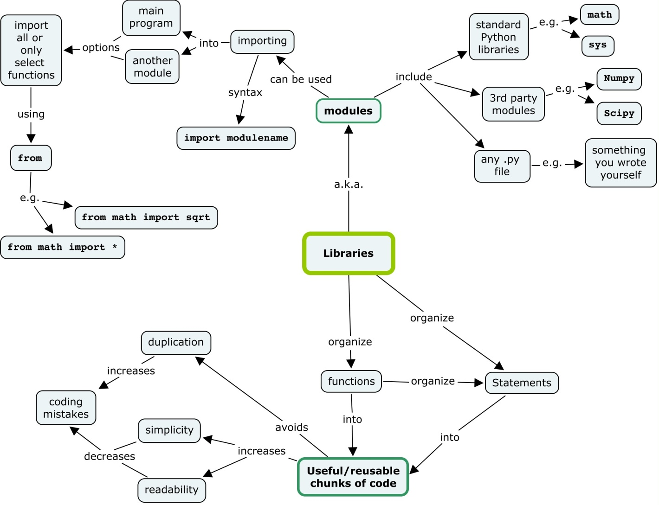
Libraries (Modules)
Notes:
http://teaching.software-carpentry.org/2012/09/07/week-1-python-libraries/

Slide 8
Python Distributions
These are packages that contain:
Interpreter (Console)
IDE
Package managers
The package manager provides a framework for the installation of modules (keeping everything tidy).
Among them are Anaconda, Canopy, WinXY, …

Slide 9
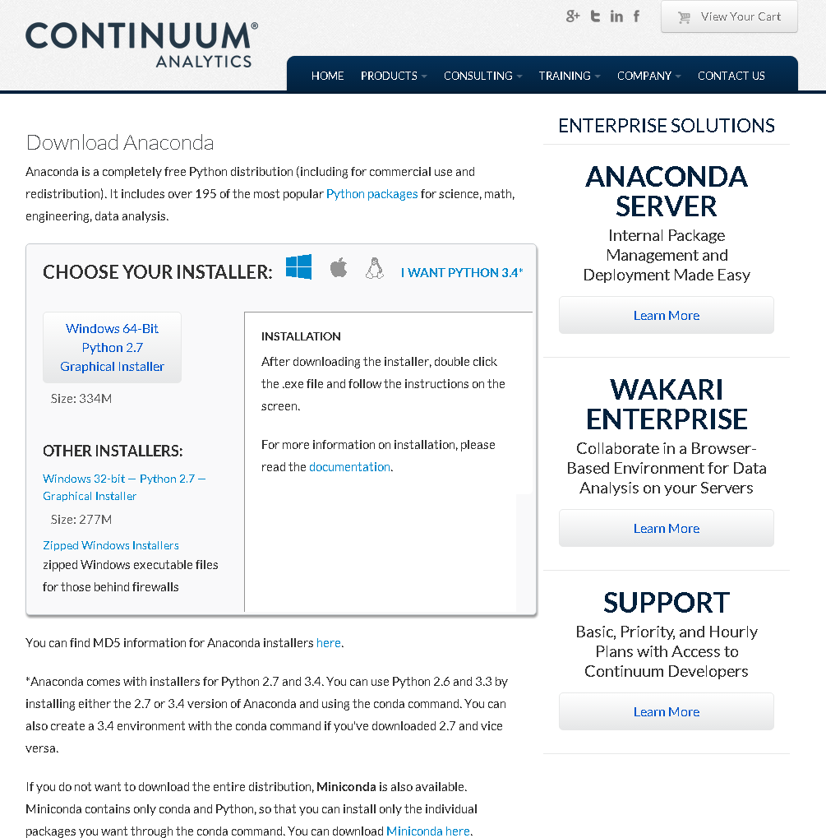
Downloading Anaconda
Download Link
Make sure you download python 2.7 for this course

Slide 10
Anaconda functionalities
Python and Ipython interpreters (console).
Spyder IDE.
Ipython Notebook.
Conda, PIP and easy_install package managers.
Easy to setup and maintain.

Slide 11
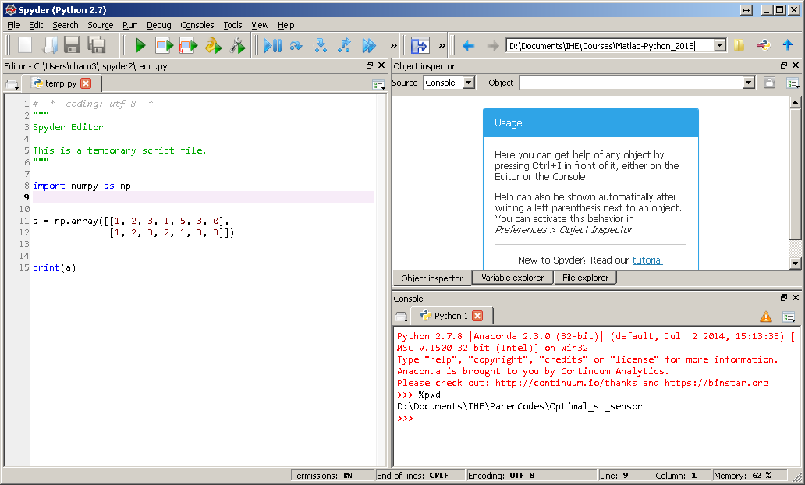
Spyder-IDE

Slide 12
Spyder-IDE Editor

Slide 13
Spyder-IDE Object inspector

Slide 14
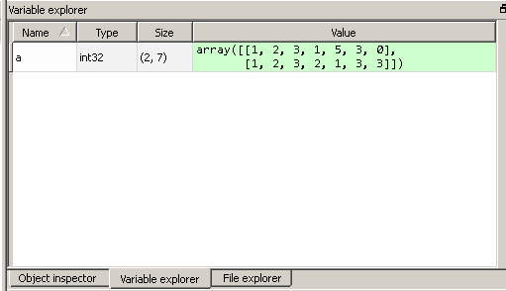
Spyder - IDE Variable Explorer

Slide 15
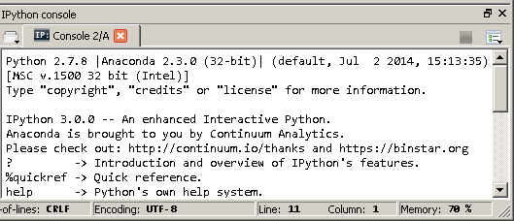
Spyder-IDE Python Console

Slide 16
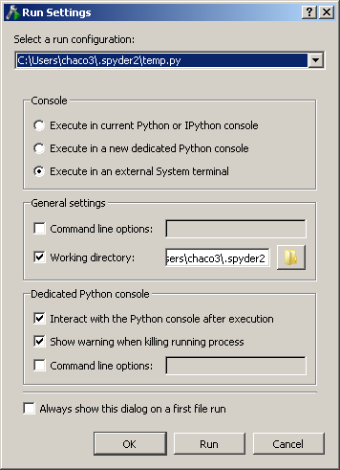
Run settings

Slide 18
Path Management
4 different paths can be identified
Editor path (Where the script is located)
Console path (Where the interpreter is working – ‘%pwd’)
New Working directory (Where new consoles are being opened)
Python path (Where this interpreter is looking for files and modules – ‘sys.path()’ )
Additions to the path can be set by using ‘sys.path.append(‘directory_2\\directory_1’)’

Slide 19
Important remarks!
Everything is an Object
By default python 2.7 declares the variables with the less memory consumption.
In other words, 1/3 = 0 and 1/3.0 = 0.33 (Fixed in v.3 or using division from __future__)
Indentation is mandatory
Package managers will make your life easier

Slide 20
Indentation
Python does not use parenthesis to indicate blocks of code, instead of that uses indentation.
Blocks of code must have the same indentation, however is a good practice to keep them all at the same spacing (4 char)
Do not mix spaces and tabs (IDE usually takes care of this)

Slide 21
Data types
Has 4 main data types:
Numbers
Integers, Bool, Floating point, Complex.
Sequences
Lists, Tuples, Iterables.
Sets
Sets, Frozen sets.
Mappings
Dictionaries.

Slide 22
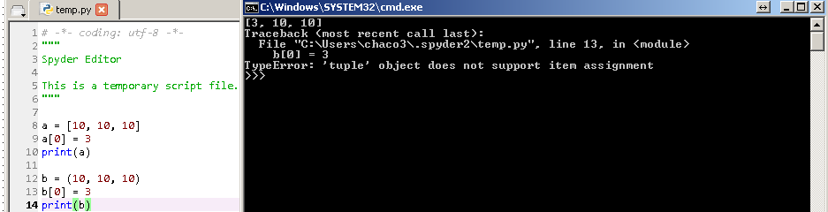
Sequences
Can be accessed with square brackets [ ].
Lists can be modified -> [ ]
Tuples cannot be modified -> ()
Iterables cannot be directly accessed, but improve performance in loops -> xrange()
Sequences start with 0

Slide 23
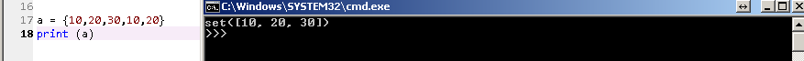
Sets -> {}
Contains a list of unique elements.
Sets cannot be accessed as order is not kept.
To further operate sets is useful to turn them into lists

Slide 24
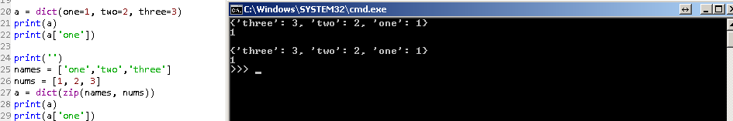
Mappings
The concept is similar to lists, with the difference that the index value is explicitly defined.
Dictionaries can be set from direct declarations (one=1) or by using zip of lists.

Slide 25
Defining functions
Functions are an essential part of coding as encapsulates recurrent operations, increasing code reusability and maintenance.
In Python the arguments can be passed as: Required, Optional, Positional or as Keywords.
They should be adequately indented.
Always start with def, a function name, round brackets ‘()’and colon ‘:’.
finish with a return command.

Slide 26
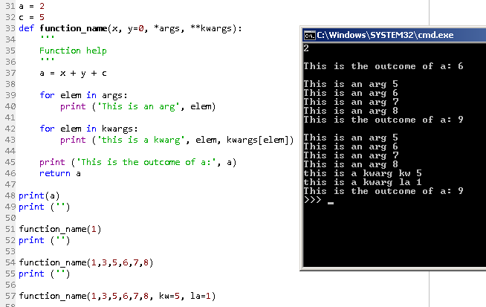
Function example

Slide 27
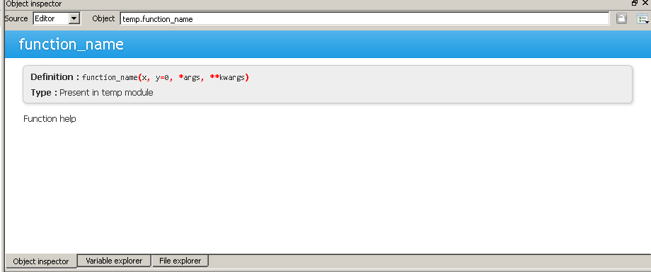
Help in the Object Inspector

Slide 28
Loops
Two basic loops are implemented: for and while.
For loop will iterate over a sequence of elements until it is done.
While will be executed until a condition is met.
Can be controlled by break, continue or pass

Slide 29
if – else statements
Conditionals are applied to execute a part of the code if a condition is met.
The conditional syntax goes ‘if condition:’
If a second condition is required, a ‘elif condition:’ is issued
In case the condition is not true, an ‘else:’ is used.
Conditionals can be applied by indenting the subsequent code after the statement.

Slide 30
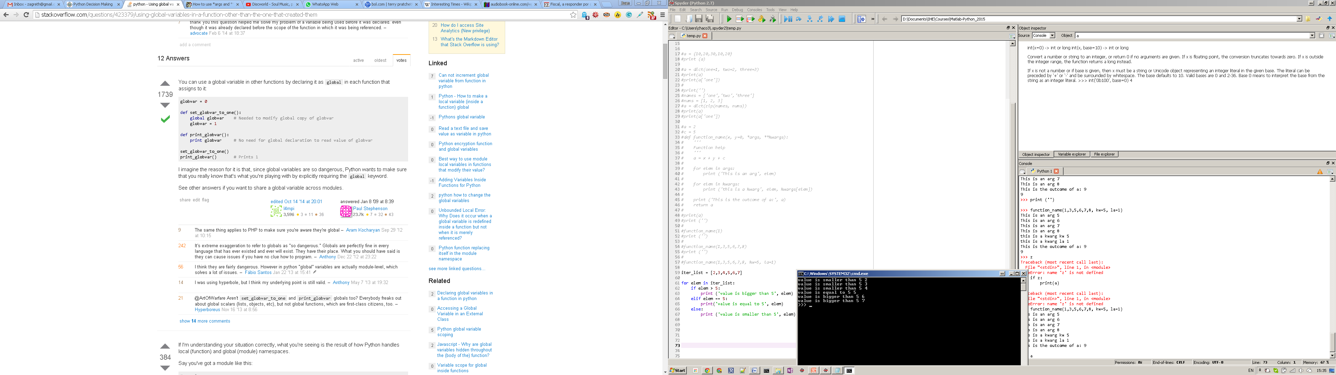
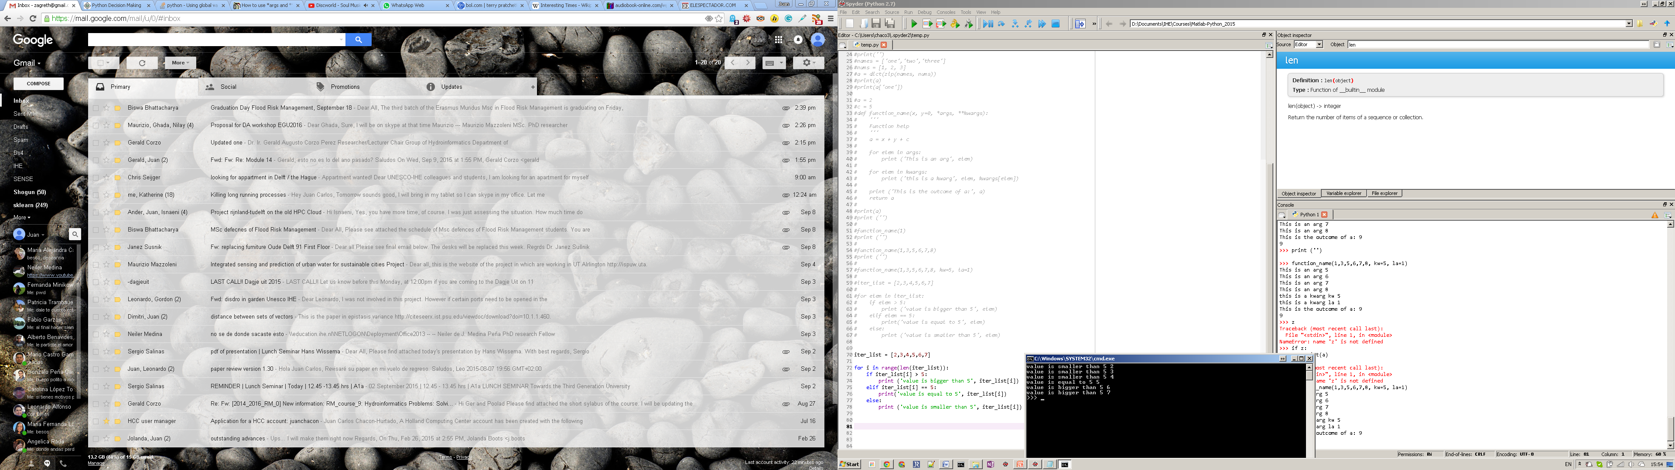
Loops and conditional example

Slide 32
Modules
Store objects (such as constants, functions or classes) which can later be accessed.
They are used by using the import statement.
Objects can be accessed as:
Module_name.object
If only an object from the module want

Slide 33
Module import options
Import the complete numpy module
import numpy
Import the numpy module with an alias (np)
import numpy as np
Import an specific object from the module (sum)
from numpy import sum
Import all the functions to current namespace
from numpy import *

Slide 34
Fundamental modules in scientific computing
Numpy
Allows the use of N-dimensional objects (similar to matrices in Matlab)
Provides mathematical, linear algebra and random number generation, among other tools
Scipy
Contains several routines for statistical analysis, numerical integration and optimisation, among others

Slide 35
Fundamental modules in scientific computing
Matplotlib
Is one of the most widely used visualisation libraries.
The interface is quite similar to Matlab, as functions have similar names and usage.
Pandas
Is a powerful library for data analysis.
Uses concepts of dataframes similar to R
This will not be introduced in this course

Slide 36
Common module aliases
numpy as np
scipy as sp
matplotlib.pyplot as plt
pandas as pd

Slide 37
Getting more modules
Usually well developed packages are published through pip or conda (package managers)
To install, just type in the cmd:
conda install (package_name)
pip install (package_name)
easy_install (package_name)
Each of the previous options represents a repository, in which your module may or not be.

Slide 38
Unpublished modules
Distutils
When installing a module from an outer source (compiled with distutils package), you must type:
python setup.py build
python setup.py install
If all the pre-requisites are available, the module will install without problems.
Depending on the module to be installed, you may require C, C++, Fortran or Java compilers.

Slide 39
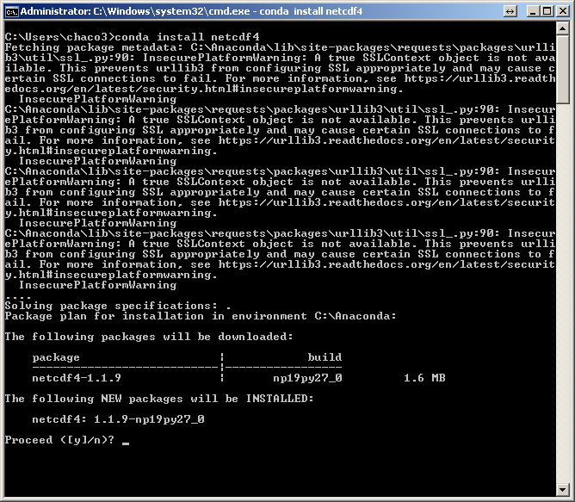
Getting netcdf4 package

Slide 40
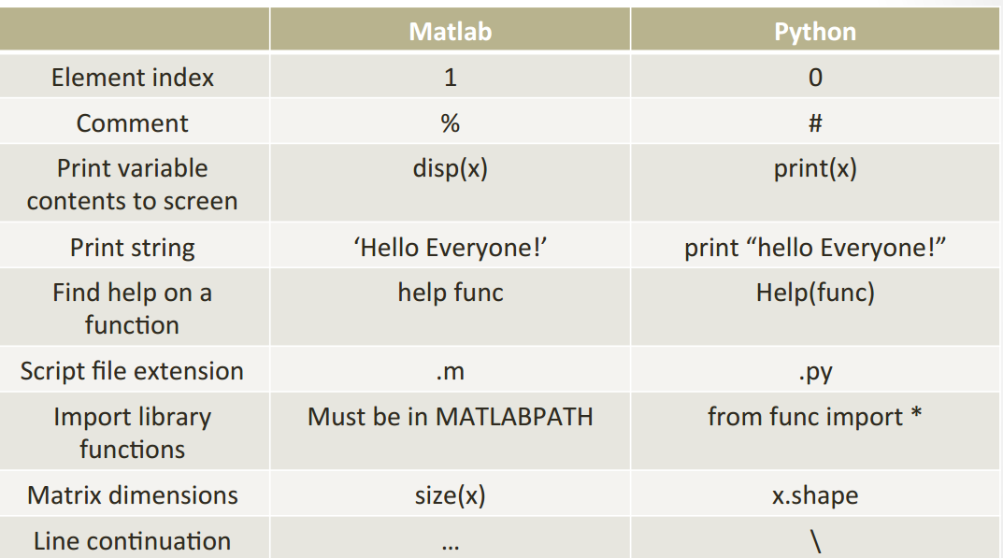
Matlab -> Python general sintax

Slide 41
File I/O
There are several options for interaction with files.
Direct modification by reading/writing line by line.
Using libraries such as numpy or pandas for interaction with common data storage types (CSV, JSON, TXT, etc)

Slide 42
Storing python objects
The Pythonic way of storing objects is using pickle (or cPickle), however it has limitations.
Dill has become an interesting alternative, especially used in HPC.

Slide 43
Reading CSV file from Python

